Slide 1
Priority Hub
Luis Aguilar
Tyler Tam
Trevor Eichler
Andy Li
Lam Tran

Slide 2
TABLE OF CONTENTS
Product
Our application
Features
UX
Demo
Software engineering process
Team building
Project management
Source code management
Testing

Slide 3
Product
1

Slide 4
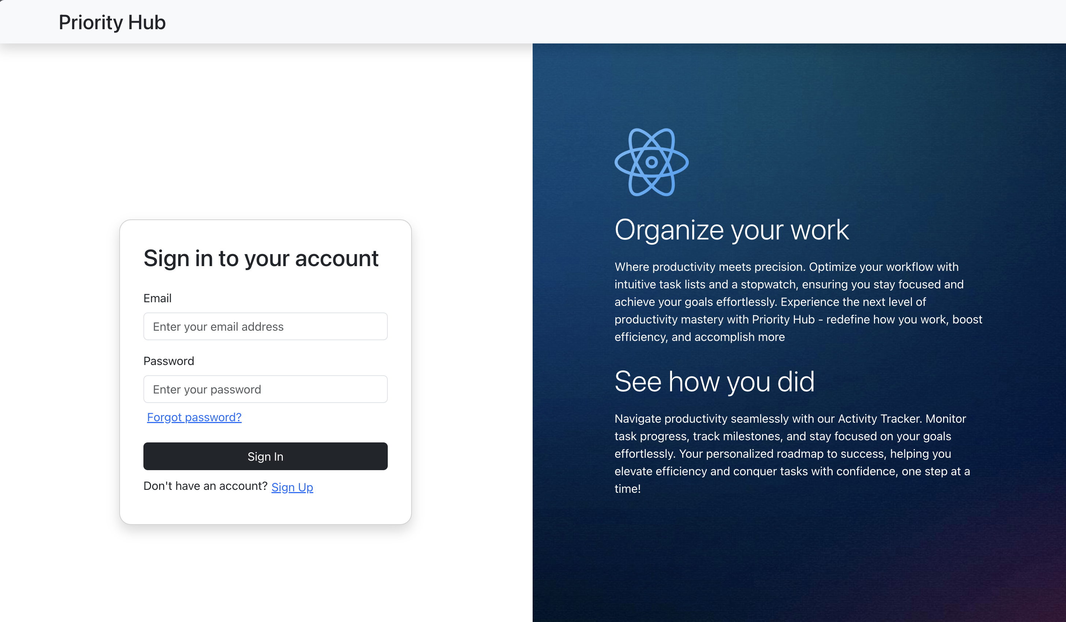
Our application
Priority Hub is a productivity application that allows users to efficiently manage their tasks. With its user-friendly interface, the app enables users to keep track of their tasks and gain valuable insights through intuitive dashboards.

Slide 5
Features
Task management
Create tasks, assign them a category, search through them.
Activity tracker
Keep track of how much time you’re spending on each task.
See the summary of your day
How you did during the day?
Dashboard
Check how you spent your time in the last week, month, or year.

Slide 6
Personas
High school students
Undergraduate/graduate students
Studying
Studying and working
Employee of a company

Slide 7
Benefits
Keep track of how much time you’re spending on your tasks
Gain valuable insights into how you’re spending your time within a day, week, month, or year period.
Gain a deeper understanding of how you invest your time so you can make informed decisions.

Slide 8
UX Principles
Usable
Each action only requires 1-2 buttons.
Simple enough to allow everyone to use it easily.
Responsive design for small screens.
Useful
Allows tracking of tasks to stay organized. Includes stopwatch to stay focused and productive.
Summary and dashboard page to show productivity.
Findable
No features are hidden behind menus and buttons.
Major features are displayed in sidebar
Accessible
Website uses black-and-white monochrome.
Optional dark mode.
Credible
All information that is tracked is shown to you. None is hidden.
As a task management website, it does not rely on external sites.
Desirable
Provides productivity data that other sites do not provide.
Smooth experience while using the app due to optimal performance.

Slide 9
DEMO
URL: http://54.162.22.91/

Slide 10
Software Engineering Process
1

Slide 11
TEAM BUILDING
What we did to build a good team?
Communication
Being transparent
Asking for help
Being clear and coherent
Organization
Weekly meetings (flexible)
Jira Board, OneDrive folder, GitHub
Staying up to date (GitHub repositories, discord)

Slide 12
PROJECT MANAGEMENT
Jira
We used Jira to manage our project
Each member was assigned a task in Jira and each task may contain smaller tasks that connects to the main task
We used Confluence to organize the structure of our project
Weekly meetings
Every week we had team meetings where we discuss our current progress on the features we were working on.
We used meetings to discuss the current features we're implementing and how are we implementing these features
One Drive
We used OneDrive to manage our files for the milestones’ deliverables.

Slide 13
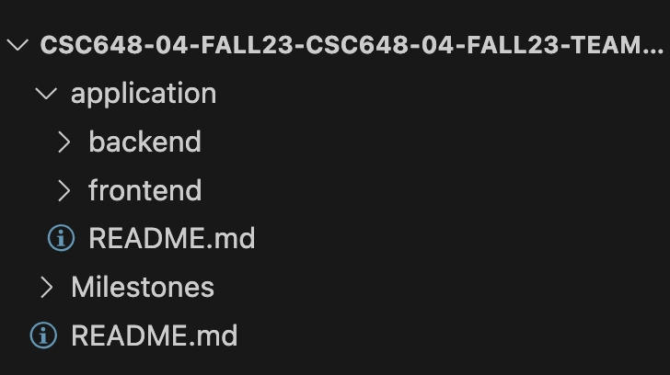
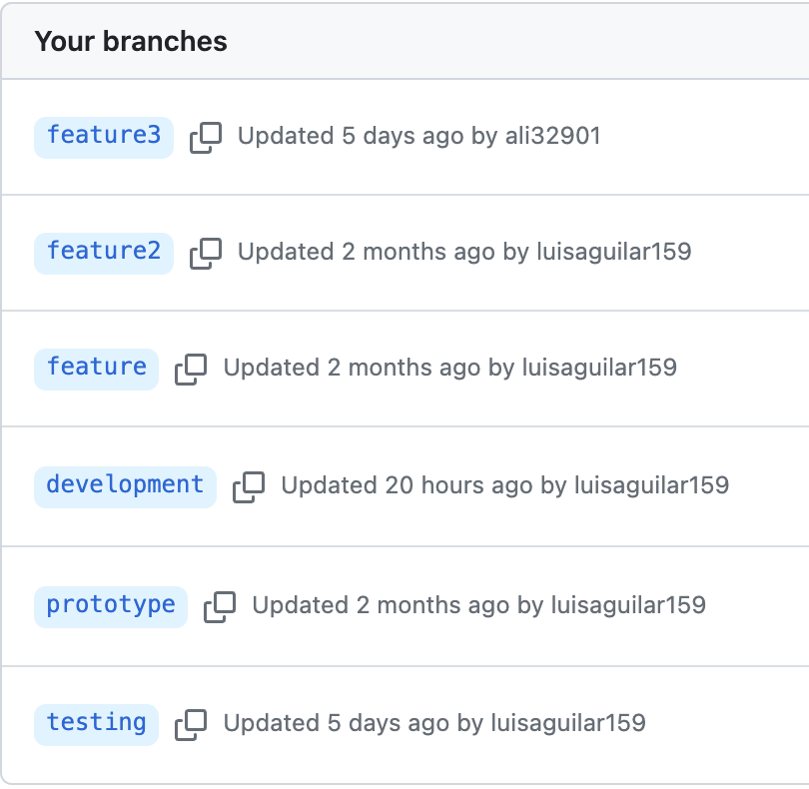
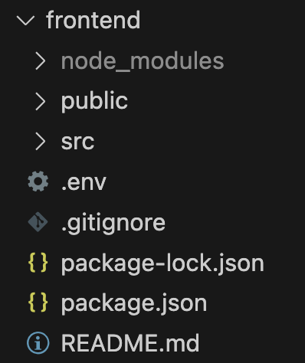
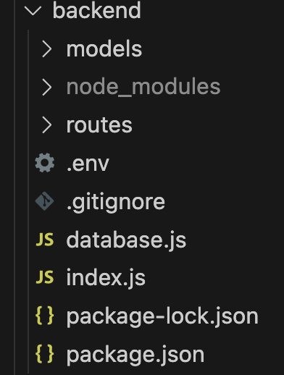
SOURCE CODE MANAGEMENT

Slide 14
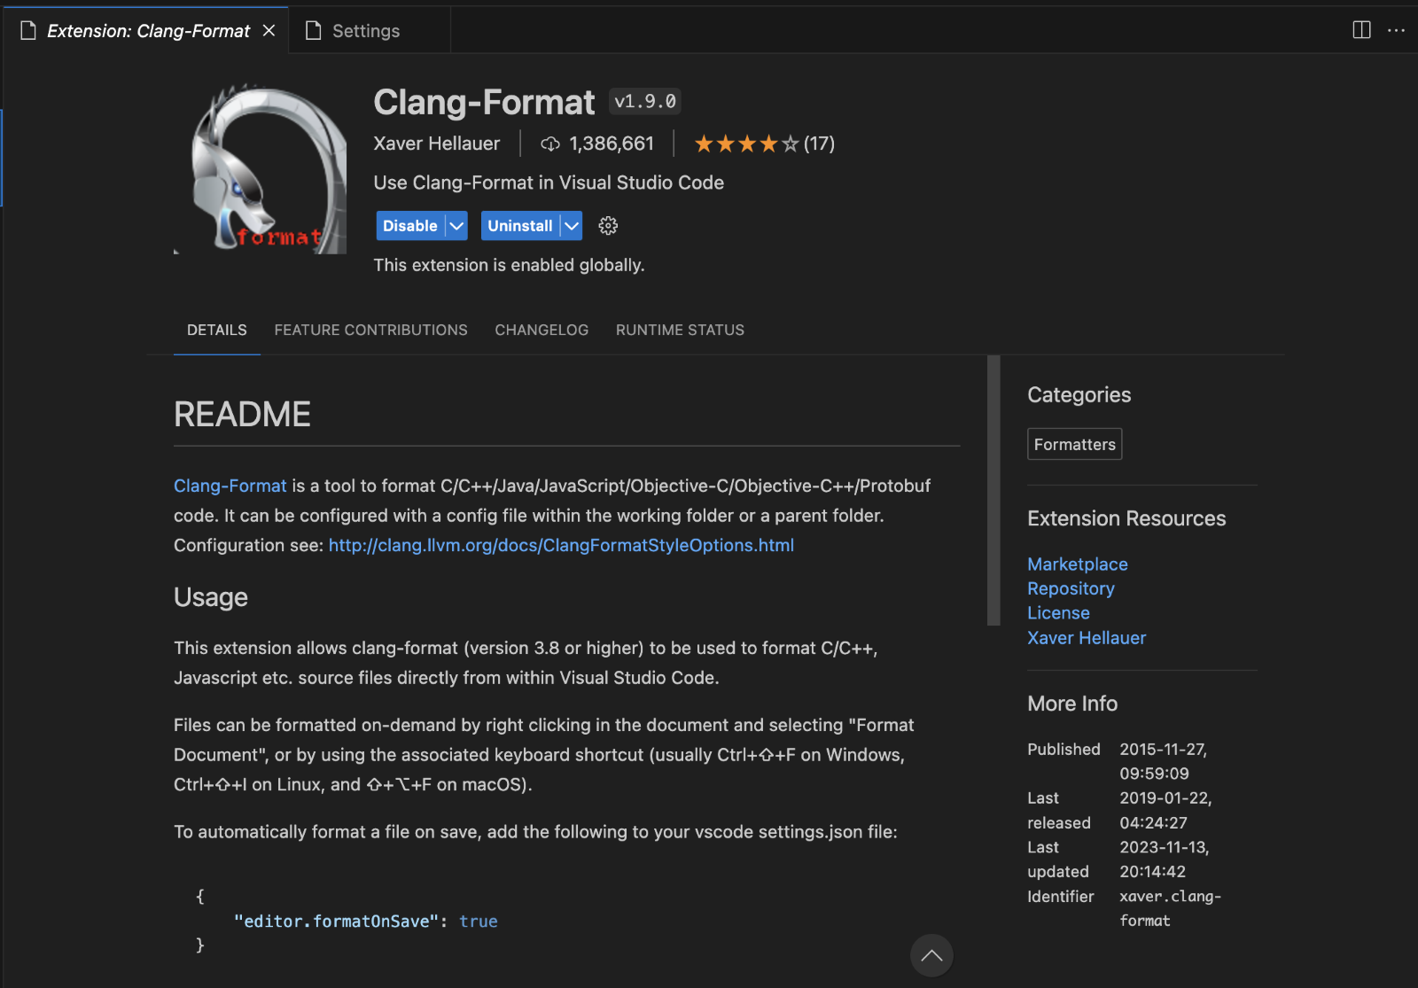
SOURCE CODE MANAGEMENT
We chose the Google JavaScript Style Guide for our application coding style.
We decided to use Google’s style guide because our application uses JavaScript as the main programming language
React for Frontend and Express + NodeJS for Backend
Our team enforced coding style using the Clang-Format extension in VSCode.

Slide 15
UNIT TESTING
Use JEST for application unit testing
Examples of unit tests
Verify that the Sign In form loads with a submit button
Verify that the email field only accepts emails.
When creating a task, verify that the application does not allows the user to use empty/blank values
When editing a task, verify that the application allows to select a different category for the task.
When tracking the time for a task, verify that the application displays a Start button.
Verify the function that gets the list of tasks returns an array as its output.

Slide 16
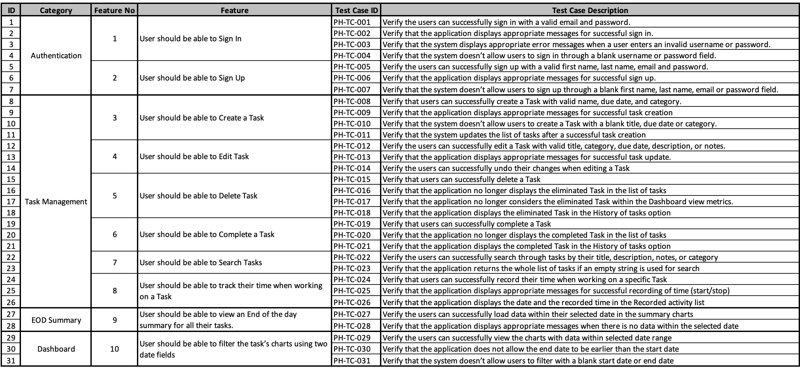
INTEGRATION TESTING

Slide 17
Priority Hub
Luis Aguilar
Tyler Tam
Trevor Eichler
Andy Li
Lam Tran

